Slide 1

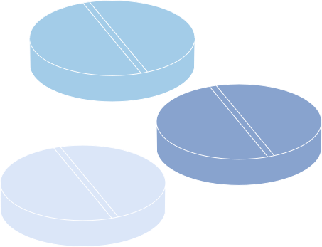







Additive Frailty Models For Recurrent Events In Cancer Research
Project By:
Mrunal Ghadigaonkar (A005) Sailee Shedge (A006) Grishma Mehta (A007)
Alisha Mali (A008) Prachit Phanse (A009)
Mentored By: Mangesh Kutekar

Slide 3

Objective
To develop and validate a statistical model that captures individual susceptibility and recurrence patterns in cancer patients by integrating both observed and unobserved risk factors, enabling improved understanding of cancer recurrence.
Research Objective
To show Cox PH model is not appropriate.
To identify which frailty distribution is appropriate.
To identify the covariates which impact hazard rate.
To calculate individual frailty

Slide 4
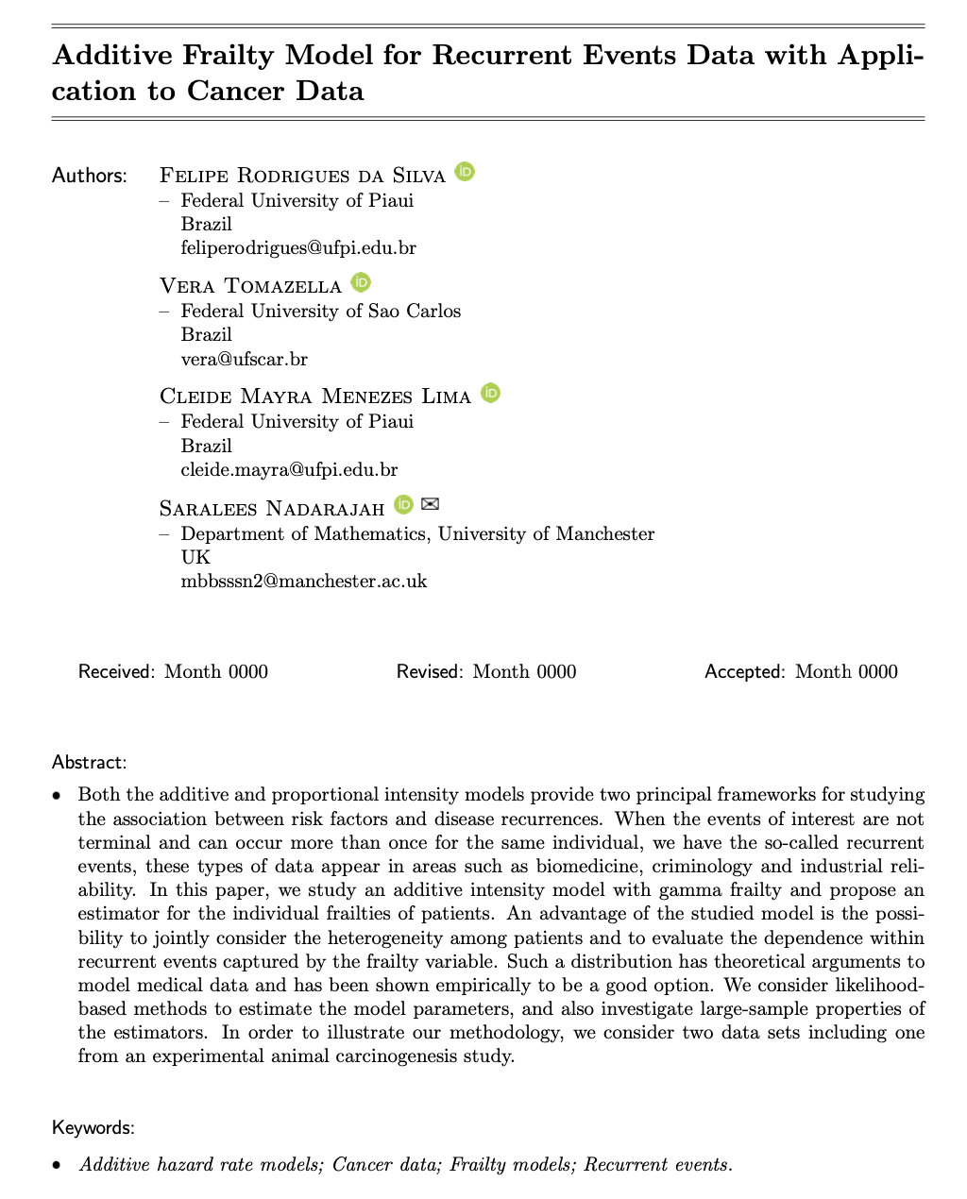
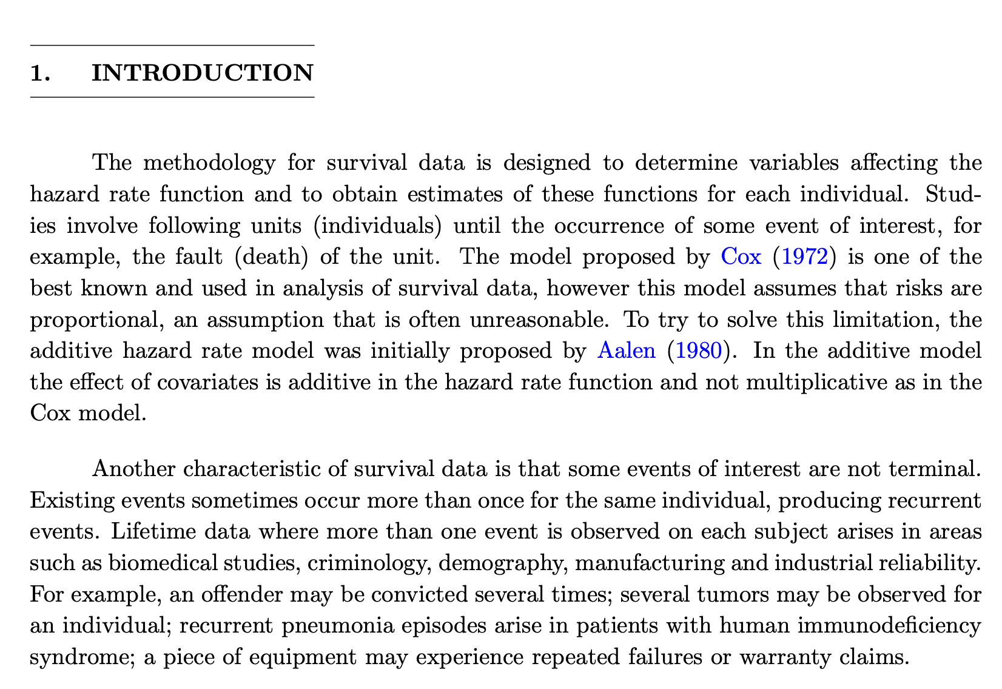
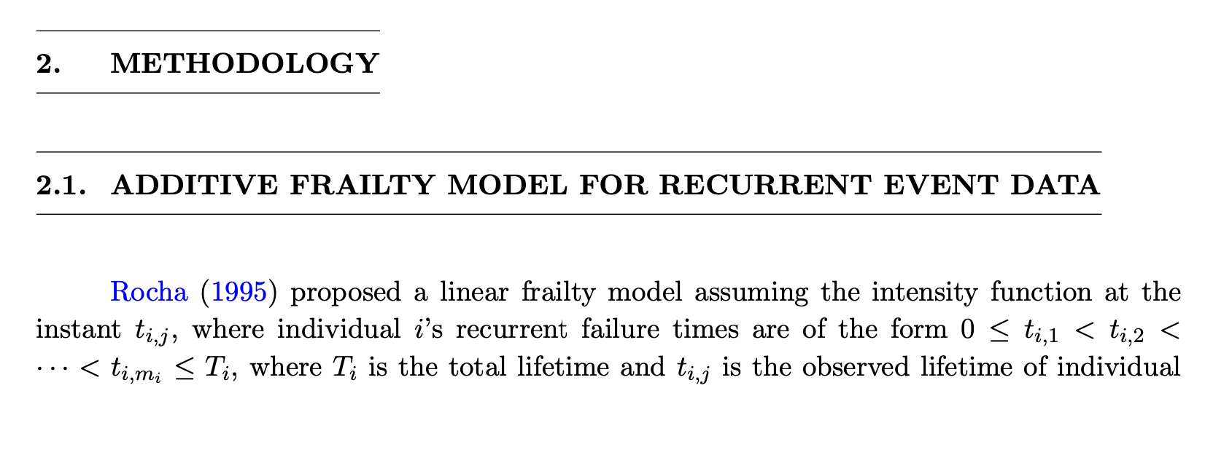
Research Paper

Slide 5
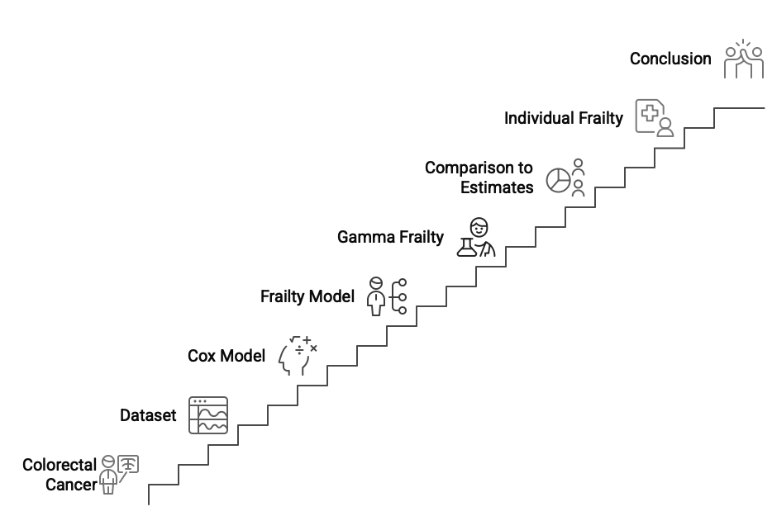
Outline

Slide 6
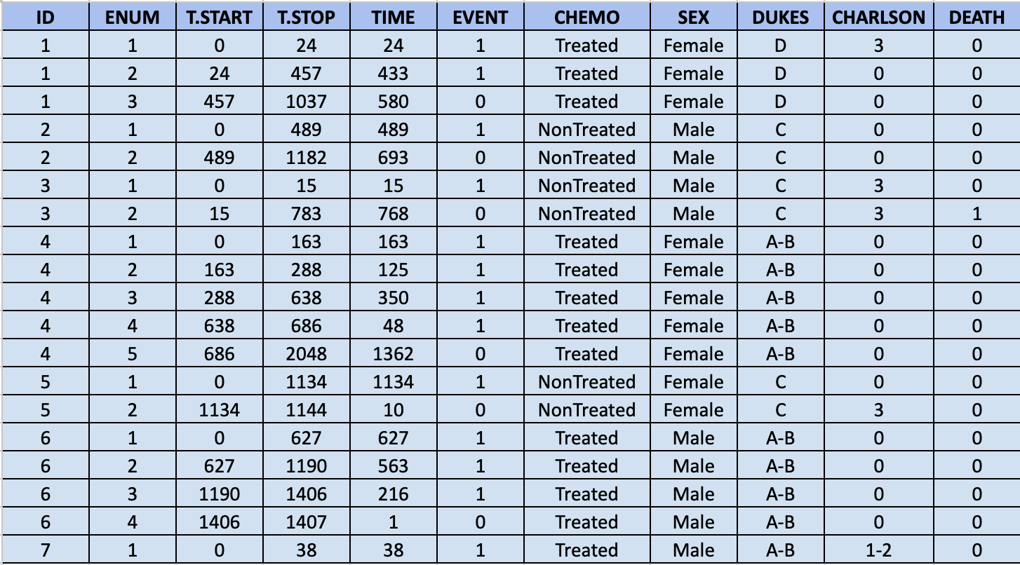
Dataset
ENUM-Serial number of event
T.START-Beginning of study
T.STOP-End of study (after event)
TIME-Time taken for event occurrence
EVENT-Indicator for event
CHEMO-Chemotherapy status
SEX-Gender of patient
Dukes-Cancer stage
Charlson-Cancer grade
Death-Indicator for death

Slide 7
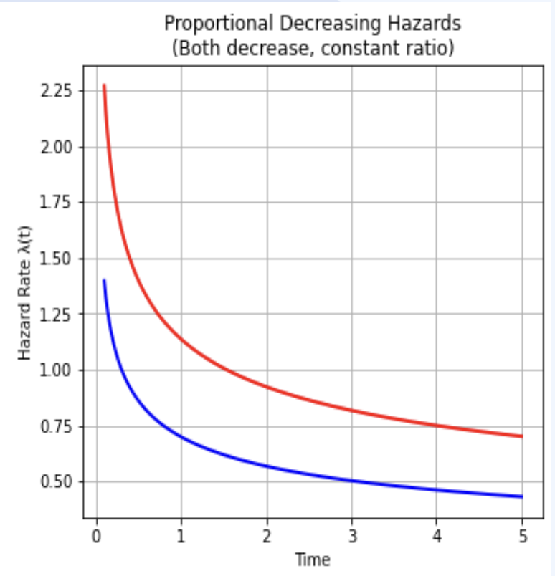
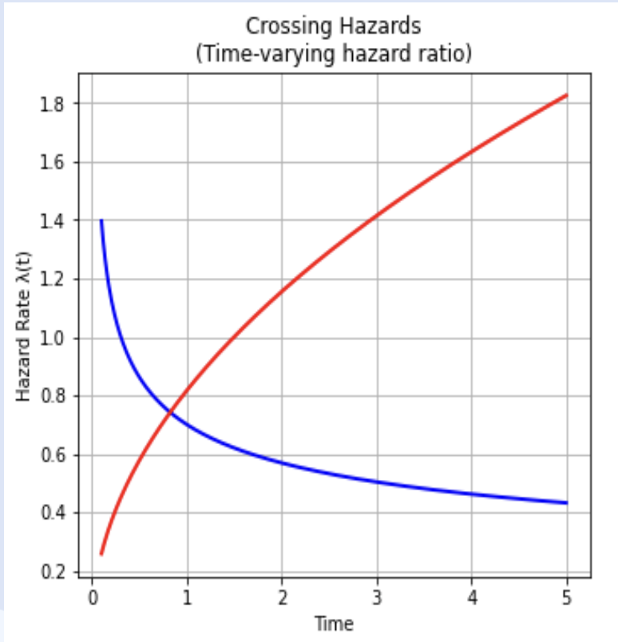
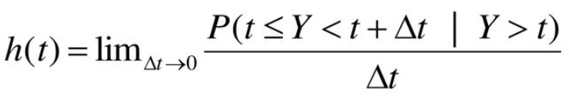
Hazard Function
Instantaneous risk of event occurrence

Slide 8


Cox Proportional Hazard Model
Semi parametric.
Used to model the hazard function h(t) given covariates h₀(t) is the baseline hazard.
exp(ꞵ₀+β₁X₁+β₂X₂+β₃X₃+β₄X₄) is the covariate term.
The Cox PH estimate of hazard function is:
h(t)=h₀(t)exp(ꞵ₀+β₁X₁+β₂X₂+β₃X₃+β₄X₄)

Slide 9
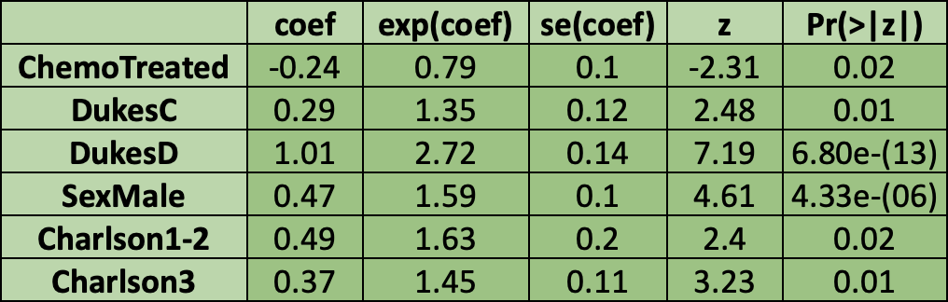

Cox Model Obtained From Our Data
All the coefficients obtained are significant.
Model is a good fit to data.
But is it an “appropriate” fit ?

Slide 10

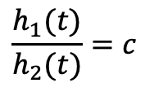


Assumptions Of Proportional Hazards
Patient 1:
Sex: Female
Chemo: Treated
Duke’s stage: A-B
Charlson stage: 1-2
Patient 2:
Sex: Male
Chemo: Not treated
Duke’s stage: C
Charlson stage: 3

Slide 11
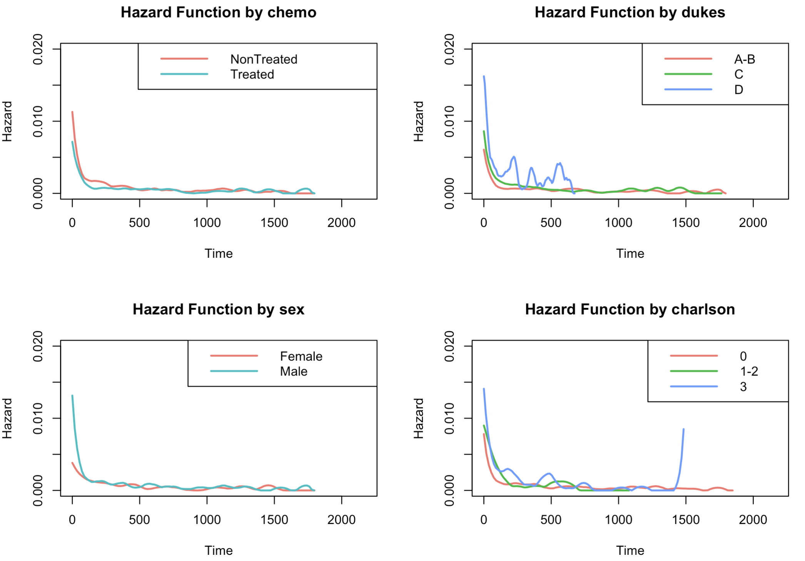
Graphical Visualizations of Hazard Functions
We observe crossing hazards are present for almost all of the covariates.
Suspecting non-proportional hazards.
Confirmation with hypothesis test required.

Slide 12

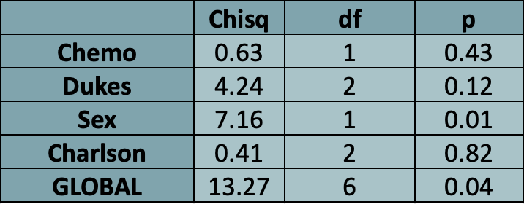
Schoenfeld Residuals Test
H₀: The proportional hazards approximation holds true for the given covariate.
H₁: The proportional hazards approximation does not hold true for the given covariate.
This test uses the Schoenfeld residuals to perform the Grambsch and Therneau test.
Proportional hazard approximation does not hold true for covariate sex.

Slide 13


Should We Remove Covariate Sex?
Sex is the only covariate that is not following the proportional hazards assumption, we might be able to simply remove it.
We know from medical literature that males are affected more than females.
We need retain the covariate.
Alternate model which can work with non-proportional hazards is required.

Slide 14
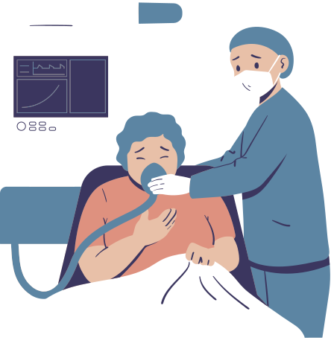
Frailty Model
A Frailty Model is a model for time-to-event data, where the frailty has a additive effect on the baseline hazard function, accounting for unobserved heterogeneity and dependence among event times.
Represents latent risk factors (e.g. genetic susceptibility).
Individuals with higher frailty experiences events earlier.

Slide 15
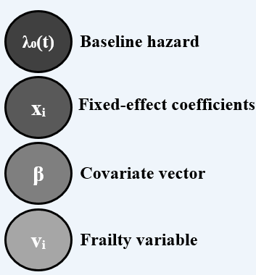
Additive Frailty Model For Recurrent Events
This model incorporates the frailty term into the hazard function in an additive way.
For recurrent event data, the additive frailty model is defined as:
λᵢ(t|vᵢ,xᵢ) = λ₀(t) + xᵢβ + vᵢ

Slide 16

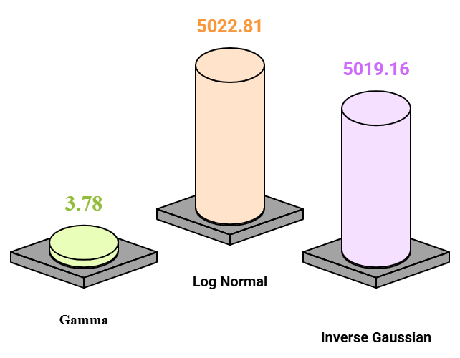
AIC Values For Different Frailty Distributions
Gamma distributed frailty is best as it has the least AIC value i.e. 3.78

Slide 17
Gamma Additive Frailty Model
The Gamma Frailty model is preferable due to the possibility of finding individual frailties.
λᵢ(t|vᵢ) = uᵢ + xᵢβ + vᵢ
λᵢ(t|vᵢ) : Hazard rate for patient i at time t
uᵢ: Constant baseline hazard
β: Chemotherapy effect (covariate coefficient)
xᵢ: 1, if patient received chemo
: 0, otherwise
vᵢ: follows gamma(1/𝛼,1/𝛼)

Slide 18
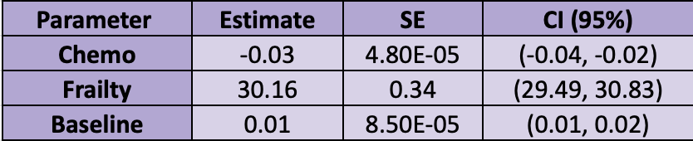
Parameter Estimates Of Gamma Frailty Model
Chemotherapy treatment is significant.
The negative value of β indicates that chemotherapy significantly reduces the risk of readmission (recurrent events) in colorectal cancer patients.
Through the values of frailty = 30.16, we observe that there is heterogeneity among patients.
As new tumours develop, the patient becomes more frail.

Slide 19
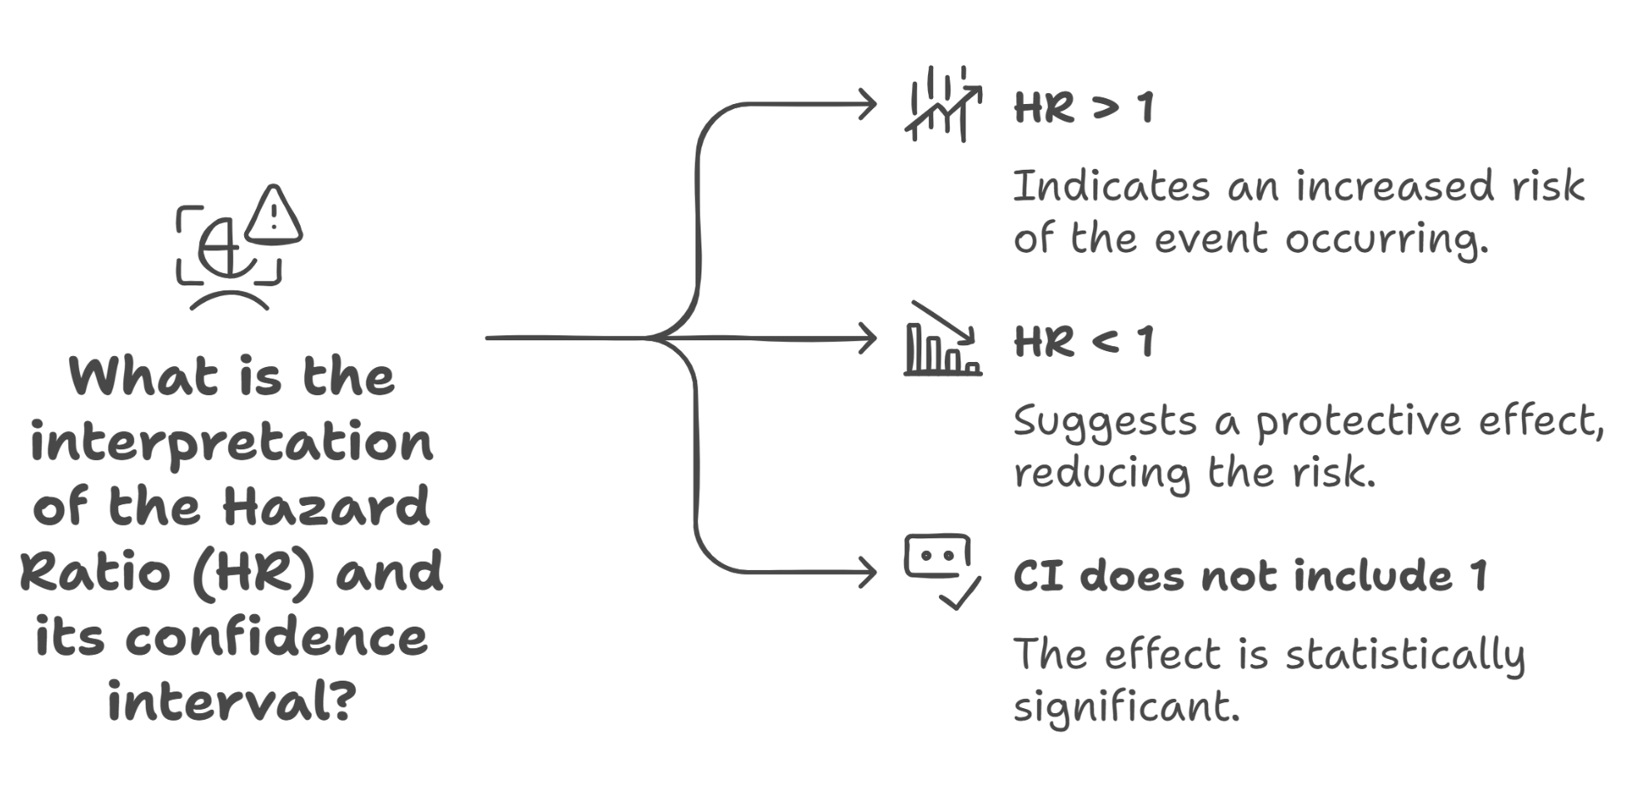
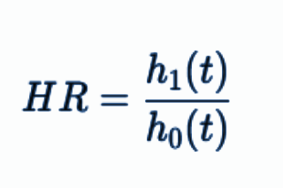
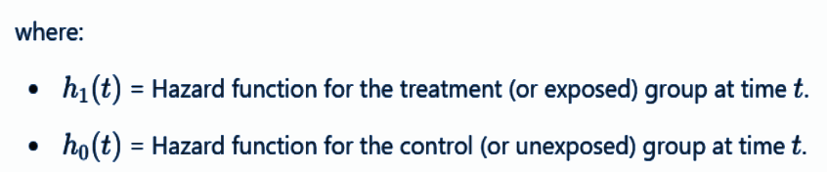
Understanding Hazard Ratio (HR)
The Melting Ice Analogy
The Hazard Ratio (HR) is a measure of how quickly an event (such as death, disease progression, or failure) occurs in one group compared to another over time. It is commonly used in survival analysis.

Slide 20
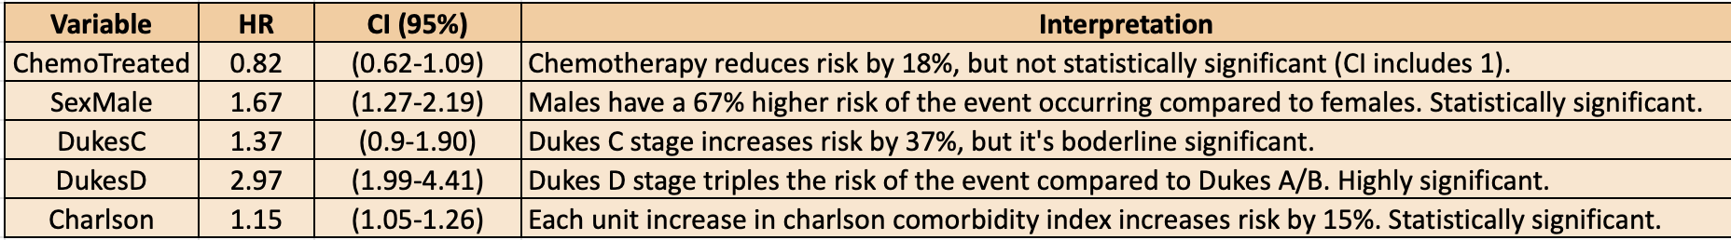
Hazard ratio for each covariate of the model
Surv(time, event) ~ chemo + sex + dukes + charlson +cluster(id)
Hazard Ratio For Each Covariate Of The Model
Surv(time,event) ~ chemo + sex + dukes + charlson + cluster(id)

Slide 21
The Discrepancy In The Significance Of The Treatment Effect
When other variables are added to the model, the treatment effect became non-significant because these variables explain part of the outcome variation that was previously attributed to the treatment.
The estimate of chemotherapy (β = -0.03) is very small, and its confidence interval (-0.04, -0.02) does not include zero, suggesting a precise but tiny effect.
In a multivariate model, this small effect may be overshadowed by stronger predictors.
The treatment likely has minimal or no independent effect when accounting for patient characteristics like cancer stage dukes C and D.

Slide 22
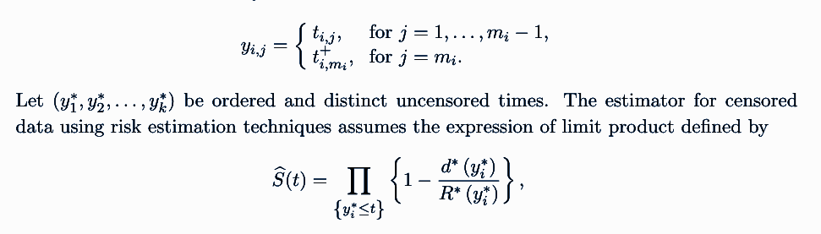
Wang Chang Nonparametric Estimator
The Wang-Chang nonparametric estimator is designed to estimate the marginal survival function for recurrent event data.
It is a reference to which we compare our gamma Additive Frailty Model
R*(t) = risk set at time t
d*(t) = number of events at time t

Slide 23
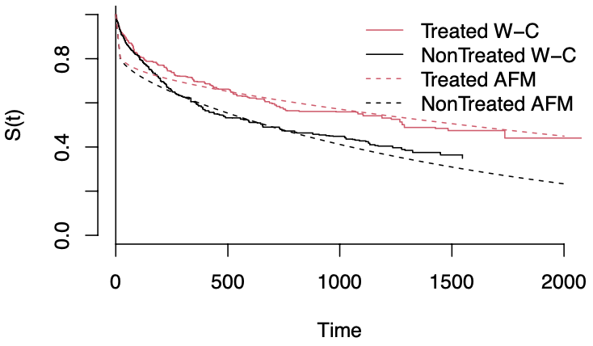
Comparison Of The Survival Curves Estimated By The Gamma Additive Frailty Model With The Curves Estimated By The Nonparametric Estimator.
The survival curves estimated by the gamma-exponential additive frailty model are very close to the curves estimated by the nonparametric estimator, which indicates a good fit of the model.

Slide 24
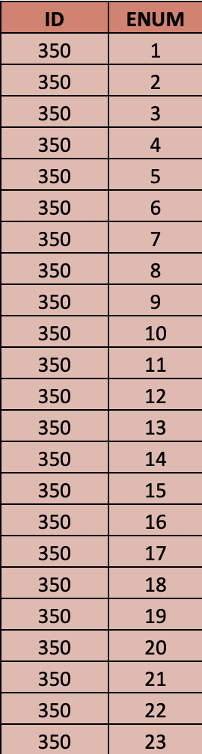
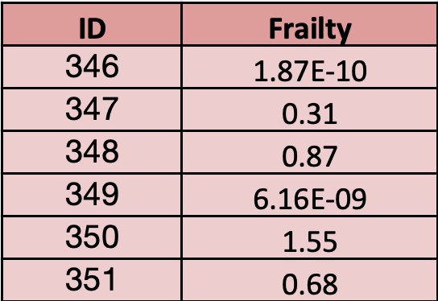

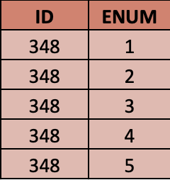
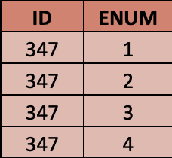
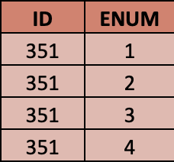
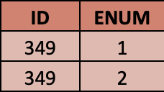
Individual Frailty
For the readmission data, we notice that the greater the number of recurrences (rehospitalizations) the greater the patient’s frailty.
Individuals not treated with with chemotherapy are generally more fragile than individuals in the group that received the treatment, which was also expected due to negative value of the estimate β.
The patient with the most readmissions (patient 350) was the one with the greatest frailty among all the patients in the study. The least frail were the patients who did not have readmissions

Slide 25
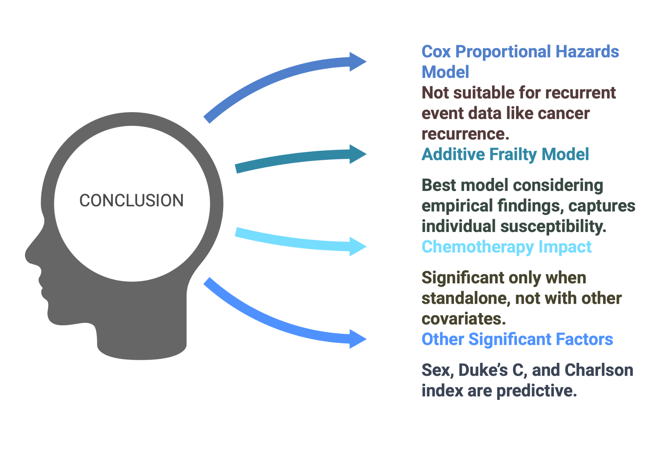

Slide 26
Thank you

